Slide 1
Topics
Introduction of MongoDB
Configuration of MongoDB
MongoDB CRUD Operations
Architecture of MongoDB
Operators

Slide 2
Topics
Data Models
Indexes
Aggregation
Security
Administration

Slide 3
Topics
MongoDB tools
MongoDB Advance Release
Replication
Sharding

Slide 4
An introduction to MongoDB

Slide 5
What is MongoDB?
MongoDB is an open source, document-oriented database designed with both scalability and developer agility in mind. Instead of storing your data in tables and rows as you would with a relational database, in MongoDB you store JSON-like documents with dynamic schemas(schema-free, schema less).

Slide 6
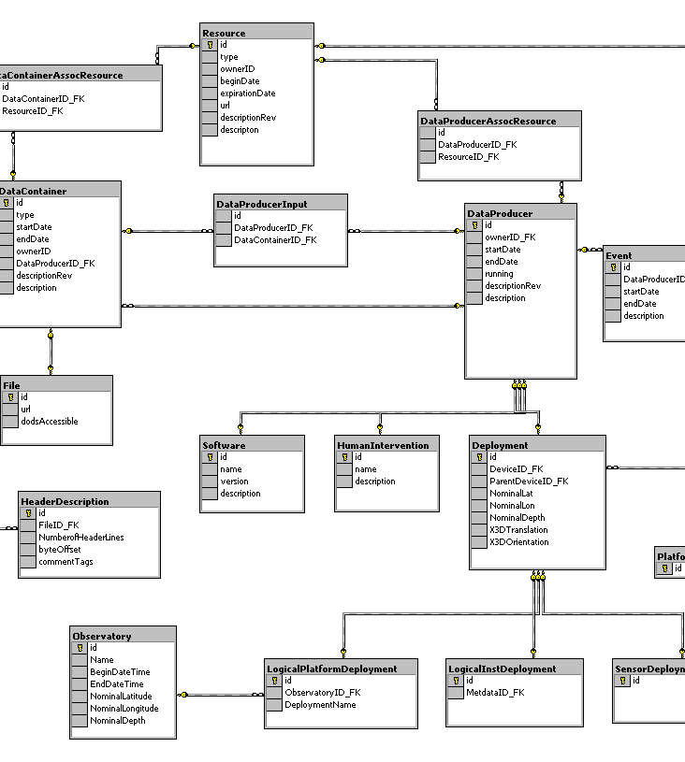
MongoDB is Easy to Use
{
title: ‘MongoDB’,
contributors: [
{ name: ‘Eliot Horowitz’,
email: ‘eliot@10gen.com’ },
{ name: ‘Dwight Merriman’,
email: ‘dwight@10gen.com’ }
],
model: {
relational: false,
awesome: true
}
}

Slide 7
Document Database
A record in MongoDB is a document, which is a data structure composed of field and value pairs.
MongoDB documents are similar to JSON objects.
The values of fields may include other documents, arrays, and arrays of documents.
Notes:
Flexible schema
Javascript

Slide 8
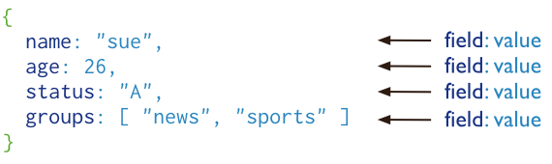
Document Structure
Database

Slide 9
The advantages of using documents
Documents (i.e. objects) correspond to native data types in many programming languages.
Embedded documents and arrays reduce need for expensive joins.
Dynamic schema.
Database

Slide 10
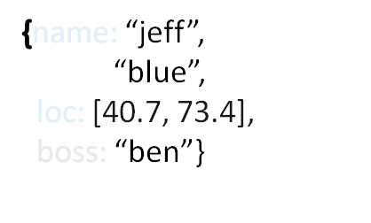



Dynamic schema
MongoDB does not need any pre-defined data schema
Every document could have different data!
{name: “will”,
eyes: “blue”,
birthplace: “NY”,
aliases: [“bill”, “la ciacco”],
loc: [32.7, 63.4],
boss: ”ben”}
{name: “brendan”,
aliases: [“el diablo”]}
{name: “matt”,
pizza: “DiGiorno”,
height: 72,
loc: [44.6, 71.3]}

Slide 11
Collection
Collection is a group of MongoDB documents. It is the equivalent of an RDBMS table.
A collection exists within a single database.
Collections do not enforce a schema.
Documents within a collection can have different fields. Typically, all documents in a collection are of similar or related purpose.
Database

Slide 12
Collection Examples
It has One collections with five documents.
{name: “will”,
eyes: “blue”,
birthplace: “NY”,
aliases: [“bill”, “la ciacco”],
loc: [32.7, 63.4],
boss: ”ben”}
{name: “brendan”,
aliases: [“el diablo”]}
{name: “matt”,
pizza: “DiGiorno”,
height: 72,
loc: [44.6, 71.3]}

Slide 13
Database
Database is a physical container for collections.
Each database gets its own set of files on the file system.
A single MongoDB server typically has multiple databases.

Slide 14
Embedded Documents
Embedded data models allow applications to store related pieces of information in the same database record.
As a result, applications may need to issue fewer queries and updates to complete common operations.
These schema are generally known as “denormalized” models, and take advantage of MongoDB’s rich documents.

Slide 15
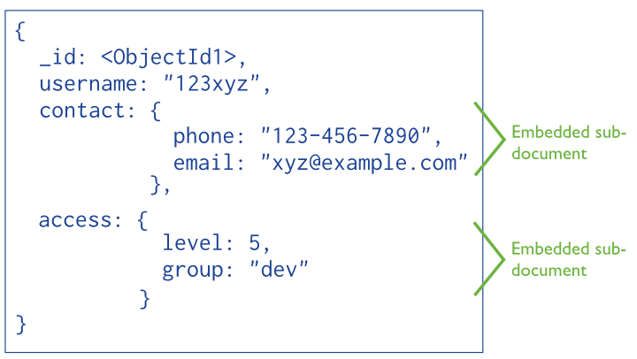
Embedded Document

Slide 16
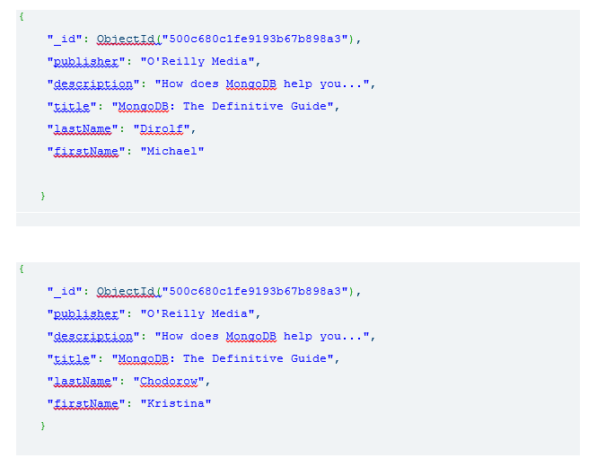
Non-Embedded Document

Slide 17
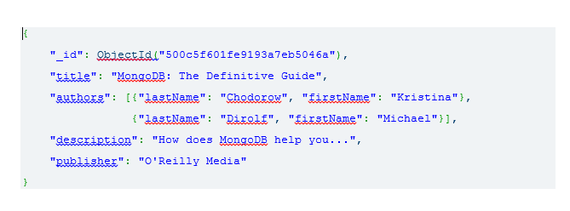
Embedded Documents

Slide 18
RDBMS VS MONGODB
RDBMS |  | MongoDB
Database |  | Database
Table, View |  | Collection
Row |  | Document (JSON, BSON)
Column |  | Field
Index |  | Index
Join |  | Embedded Document
Foreign Key |  | Reference
Notes:
Javascript

Slide 19
ObjectId
In MongoDB, documents stored in a collection require a unique _id field that acts as a primary key.
MongoDB uses ObjectIds as the default value for the _id field if the _id field is not specified.
{
"_id": ObjectId("500c680c1fe9193b67b898a3")
}

Slide 20
Object Id Examples:-

Slide 21
ObjectId constructed by
a 4-byte value representing the seconds since the Unix epoch,
a 3-byte machine identifier,
a 2-byte process id, and
a 3-byte counter, starting with a random value.

